Slide 1
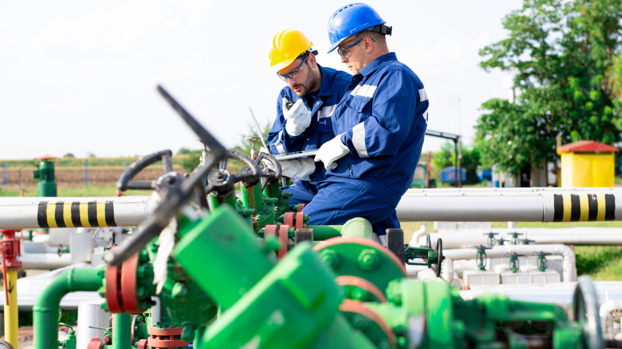
Evaluating Climate-Critical Careers
Massachusetts Climate Careers: Powering the Future
Lesson 10: Evaluating a Career in Clean Energy and Climate-Tech
|
1
Notes:
Today, we transition from focusing on different types of clean energy solutions to thinking about the careers that make those solutions possible.
Specifically, we’re focusing on the clean energy and climate-tech career sector growth and demand and how to evaluate which of the many different clean energy or climate-tech jobs could be the best fit for you.
You’ll explore how your skills, interests, and values align with potential careers in this rapidly growing field.

Slide 2
Opening Activity
Ask your classmates “yes” or “no” questions to identify your career.
Who am I?
Lesson 10: Evaluating a Career in Clean Energy and Climate-Tech
Notes:
Activity objective: Encourage students to consider what they can already identify about different careers in climate tech and clean energy based on what they’ve learned about clean energy solutions in the first half of this course.
Set-up: Before class, write different clean energy careers on Post-it notes so they are ready to hand out to students as they come in.
Instructions
Give each student a Post-it note with a clean energy career. Students should NOT look at their Post-it, but instead, stick it on their forehead so others can see it. Ideas include
wind turbine technician
solar salesperson
EV automotive technician
architect
utility worker
engineer
insulation worker.
Students have three minutes to move around the classroom, asking one another “yes” or “no” questions to identify the career on their forehead.
Example questions:
Do I work outside?
Do I work at heights?
Do I work with lots of different tools?
Do I work on a team?
Do I usually wear protective equipment?
Do I work at a computer most of the day?
After three minutes, let all students make a final guess at the career on their forehead before looking at their Post-it note.
Ask some students to share their reactions to the exercise; what was challenging? What kinds of questions were most helpful? Did they know more careers than they thought? Fewer?

Slide 3
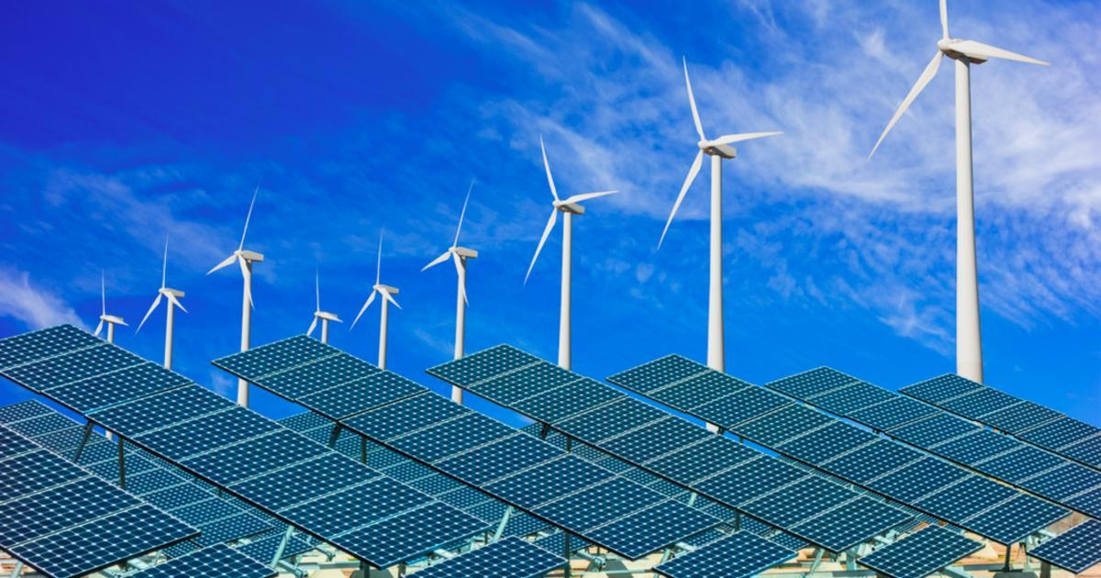
Do Clean Energy Careers Offer Opportunity?
Advances in climate-tech will result in a range of new career opportunities, but will those jobs be long-lasting, pay well, and provide opportunities for growth and promotion?
Lesson 10: Evaluating a Career in Clean Energy and Climate-Tech

Slide 4
Yes! Clean Energy Jobs are in Demand
Join the next generation of creators, thinkers, leaders, and doers, working together to tackle the climate crisis. Help to build a clean energy and climate-resilient future in your own community and across the nation.
Lesson 10: Evaluating a Career in Clean Energy and Climate-Tech

Slide 5
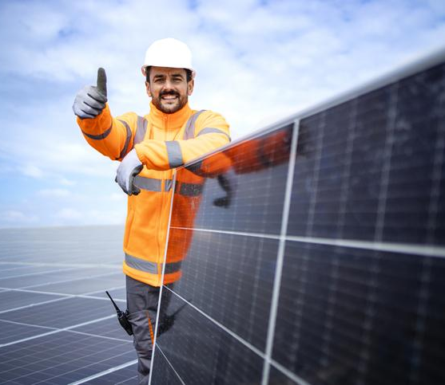
The Big Question and My Climate Goals
Finding Your Place in Clean Energy
Career Spotlights
Climate Watch Video and Discussion
Career Interest Discovery Activity
Takeaways and Closing
Lesson 10: Evaluating a Career in Clean Energy and Climate-Tech
Notes:
Walk students through the agenda for today.
The focus is on the Big Question: understanding how they can find a suitable career in clean energy and climate technology.
Explore the clean energy job market.
Discuss values, interests, and skills.
Understand how to evaluate career fit.

Slide 6
How do I evaluate which climate-critical roles would best fit me?
Lesson 10: Evaluating a Career in Clean Energy and Climate-Tech

Slide 7
When you complete this lesson, you’ll be able to:
Identify career categories and specific occupations in clean energy and climate technology.
Describe how your interests, skills, desired training, career goals, and work environment preferences affect determining the right career fit.
Recognize the growing demand and opportunity of climate-critical careers.
Lesson 10: Evaluating a Career in Clean Energy and Climate-Tech
Notes:
Review the objectives for today’s lesson and answer any questions students may have.

Slide 8
Your Place in Clean Energy
To meet the 2030 greenhouse gas emission reduction targets, Massachusetts needs 38,100 additional workers trained for climate-critical work.
Lesson 10: Evaluating a Career in Clean Energy and Climate-Tech
Notes:
There is high demand for skilled workers in clean energy fields.
Climate-critical careers are expanding, and many offer stability, making this a promising sector for future jobs.
These are dependable jobs with high-growth opportunities.

Slide 9
Career Considerations
Skills: what am I good at?
Interests: what excites me?
Work environment: what kind of setting do I work best in?
Values: what motivates me?
Growth potential: what do I want to accomplish?
Salary: how much do I need to earn?
Lesson 10: Evaluating a Career in Clean Energy and Climate-Tech
Notes:
THIS LIST WILL APPEAR ONE BY ONE WITH CLICKS
Several factors go into choosing a career, and everyone might weigh them differently.
Throughout your career, what’s important to you might change.
At any point, there are six factors that you should consider.
These are six questions you want to ask yourself as you are deciding what would be a good fit for you professionally:
Skills: What am I good at? What are my strengths? These could be skills you already possess or believe you could acquire through training and further education. But if you’ve always struggled with math, you might want to consider whether a career that relies heavily on mathematics fits your strengths.
Interests: What excites you? What do you enjoy? We spend considerable time and energy working, so you want to factor in what keeps your attention. Do you love research? Or do you love puzzles and problem-solving? These could be relevant when thinking about a career in clean energy.
Work environment: In what kind of setting do you want to spend your time? You will spend plenty of time working, so do you want to do that indoors? Outdoors? Up high? On a team? Traveling? What is important to you in a work environment? Remember that this includes workplace dynamics, the social environment, and the physical environment.
Values: What motivates you? This doesn’t necessarily mean your moral values, although those are important. This is what you care about regarding work, so do you care about relationships? Do you care about independence? Being recognized for doing good work? What matters to you?
Growth potential: What do you want to accomplish in your career? Do you want to be able to learn on the job and move up quickly? Do you want to become an expert at what you do and teach others? Do you want to be a leader in your field?
Finally, salary: How much do you need to earn? Pay rates may go up and down depending on different factors. Typically, the more specialized a role is or the more specialized knowledge it requires, the higher the pay rate is. As demand increases for clean energy jobs, pay rates may rise, too, to attract and retain more workers.

Slide 10
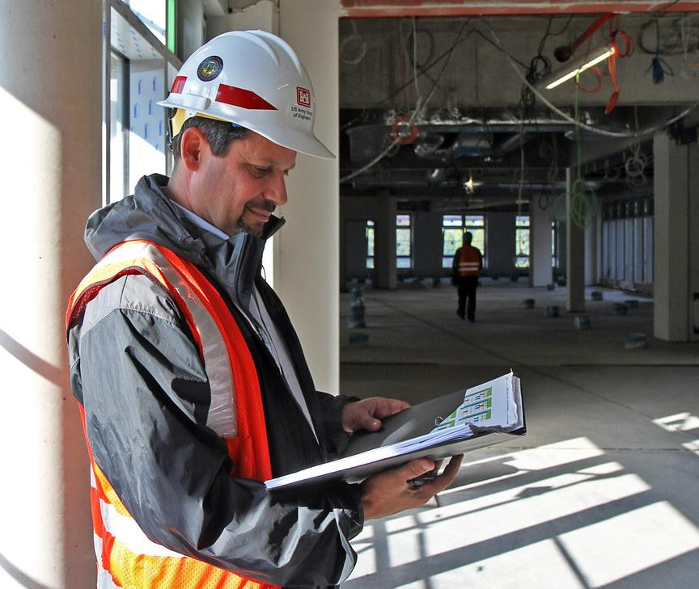
Project Manager
Project managers oversee the planning, execution, and completion of clean energy projects.
Skills: organization, problem-solving, communication, leadership
Work environment: a mix of office and work sites, working with a variety of teams
Salary Range in MA: $70,000–$90,000
Lesson 10: Evaluating a Career in Clean Energy and Climate-Tech
Notes:
Highlight some jobs poised to expand significantly in Massachusetts over the coming years.
Project managers oversee all clean energy projects, including solar panel installations, wind farms, and energy efficiency retrofits. They are responsible for planning, coordinating teams, managing budgets, and ensuring that all project goals are met on time.
This is a quick snapshot of some skills needed to be a project manager.
Organization—project managers must manage multiple tasks, deadlines, and resources simultaneously.
Problem-solving—they are the go-to person to address issues on a project, so they must be able to address concerns and find solutions.
Communication—project managers must communicate updates and instructions between team members and any other stakeholders or community members involved in a project.
Leadership—multiple teams or professionals are often involved in clean energy projects, and project managers must be able to guide and motivate them, which requires leadership.

Slide 11
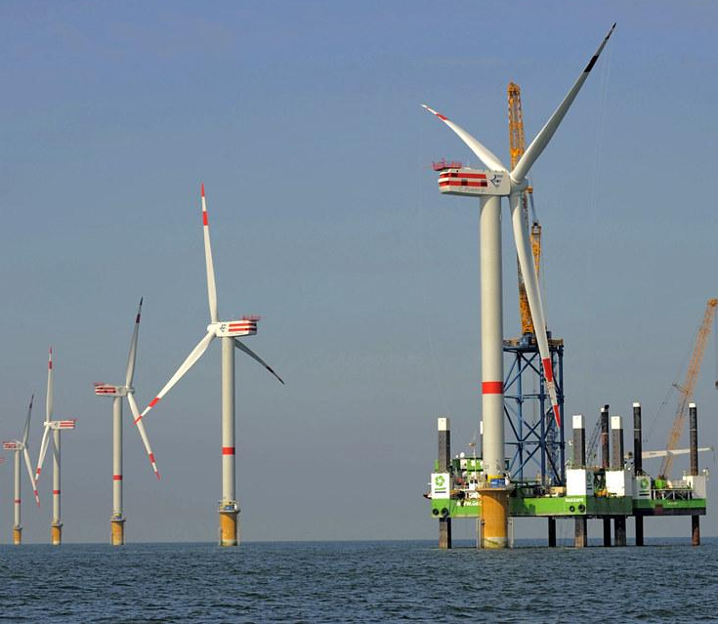
Wind Turbine Technician
Offshore wind turbine technicians maintain and repair wind turbines.
Skills: mechanical and electrical, comfortable with heights and water, troubleshooting
Work environment: works as part of a team on offshore platforms with exposure to marine weather
Salary Range in MA: $55,000–$80,000
Lesson 10: Evaluating a Career in Clean Energy and Climate-Tech
Notes:
Another area with increasing job demand is offshore wind. Massachusetts is a leader in offshore wind development, so the demand for skilled technicians will continue to grow significantly as more offshore wind projects are constructed.
Offshore wind technicians maintain and repair wind turbines, ensuring they operate efficiently.
They need to have mechanical and electrical skills.
You need to be comfortable working at heights and on the water, as offshore wind often requires working from an offshore platform.
Wind turbine technicians need to be good at troubleshooting—they don’t always know the problem, but it’s their job to solve it.
They work in all kinds of weather, and those conditions can be more intense on the water.
This is a role that requires lots of safety training.
The pay rate is anywhere from $55–80K depending on the specific role; there’s the potential for higher earnings with additional certifications or more experience.
Offshore wind is vital to Massachusetts’s climate goals, with the potential to power thousands of homes with renewable energy.
Offshore wind projects are supported by federal and state incentives, which will continue driving demand for skilled workers.

Slide 12
Energy Auditor
Energy auditors assess homes and buildings and recommend upgrades to reduce energy consumption and costs.
Skills: analysis, attention to detail, communications, building systems
Work environment: often works on their own, mostly indoors in all types of buildings, occasionally outdoors
Salary Range in MA: $50,000–$75,000
Lesson 10: Evaluating a Career in Clean Energy and Climate-Tech
Notes:
A third career poised to grow significantly, and one that does not necessarily require being comfortable with heights, is an energy auditor.
Energy auditors evaluate homes and other buildings to identify energy inefficiencies. They recommend upgrades and other changes that reduce energy consumption and costs.
Necessary skills include analytical skills, an understanding of different building systems and components, and strong communication skills. You’d be working with all kinds of people and going into their homes and buildings, often with news they don’t want to hear.
The work environment is mainly indoors, although sometimes you may need to evaluate the outside of a building or an outdoor area.
The salary in Massachusetts is $50–$75K, with higher pay for specialized assessments or consulting jobs.
Massachusetts prioritizes energy efficiency, and the demand for energy auditors is expected to grow as policies encourage energy-efficient buildings.
Energy auditors can help people upgrade existing buildings or ensure that new buildings are as energy-efficient as possible.
Energy efficiency is one of the most cost-effective ways to reduce emissions and energy costs, so it’s an excellent way for businesses to lower their carbon footprint.

Slide 13
Find Your Place in Clean Energy
Problem-Solving
Technical Aptitude
Common Skills in Clean Energy
Communication
Adaptability
Teamwork
Analytical Thinking
Lesson 10: Evaluating a Career in Clean Energy and Climate-Tech
Notes:
Over the next few lessons, we’ ll examine many of the different career paths in clean energy.
These are six of the most common strengths that we see across various career paths:
Problem-solving: clean energy roles often require innovative thinking to address environmental challenges and develop sustainable solutions.
Technical aptitude: many positions need some knowledge of technology, from software for energy analysis to hands-on work with solar panels or wind turbines.
Communication skills: communication is key in clean energy, whether explaining technical concepts or collaborating with a team.
Adaptability: clean energy technologies constantly evolve, and successful professionals can adapt to new tools, systems, and methods.
Teamwork: most roles involve collaboration, whether within a company, across community projects, or with other organizations.
Analytical thinking: professionals need the ability to assess data, interpret results, and make decisions that benefit the environment and the bottom line.
These skills may take different forms depending on the role, but they are central to many clean energy careers.

Slide 14
Climate Watch: Video
Lesson 10: Evaluating a Career in Clean Energy and Climate-Tech
Notes:
Video coming by Spring 2025.

Slide 15
What skills does Eric use on the job?
What are some ways that Eric learned new technical skills?
What stands out to you about Eric’s career discovery journey so far?
Climate Watch Discussion
Lesson 10: Evaluating a Career in Clean Energy and Climate-Tech

Slide 16
Group Activity
Career Interest Discovery
Begin to develop a career interest profile.
Discuss your answers with your small group.
Help each other uncover insights from your reflections.
Lesson 10: Evaluating a Career in Clean Energy and Climate-Tech
Notes:
Activity objective: Students answer six reflective questions to explore their skills, interests, and values, helping them to pinpoint potential climate-critical career paths. This provides a structured reflection on their strengths and preferences, enabling them to link their personality to potential clean energy jobs.
Instructions
Divide students into groups of three or four and direct them to their worksheets.
Today, students will begin to develop their career profiles based on four of the six factors introduced earlier in class.
Skills: What am I good at? Consider school subjects, hobbies, and areas where you often receive positive feedback.
Interests: What excites me? Think about topics or activities that capture your attention and keep you engaged.
Work environment: In what setting do I work best? Consider physical and social factors that contribute to settings, such as indoor or outdoor, teamwork, or working alone.
Values: What motivates me? Do you want to make a difference, earn recognition, support a team, and make significant discoveries? What will motivate you to continue doing your best work throughout your career?
Each student will complete the worksheet individually and then share their insights with their small group. Small group discussions should cover:
Were there any interests they hadn’t considered before?
Do they have an interest they might want to develop into a skill?
Answers from these activities are not final; they are a starting point—think broadly! Don’t be limited to school or what you usually consider job-related skills and interests.
Activity Debrief
After about 15 minutes, bring the attention back to the whole class.
Invite groups to share insights from their conversations; did anyone learn anything that surprised them?
Ask students to share some careers they are interested in learning more about and why.
Emphasize that clean energy careers are diverse and require a wide range of skills and interests—there’s a match for just about any combination!
In the remaining lessons, the class will examine some of the careers critical to Massachusetts meeting its clean energy goals, but this is by no means a comprehensive list.
The exercise they completed today is applicable whether they are considering careers in clean energy or any other field.

Slide 17
Understand that your career fit matters.
Clean energy careers are diverse and interconnected.
Personal reflection is an important part of career exploration.
The clean energy transition needs many different skill sets.
Lesson 10: Evaluating a Career in Clean Energy and Climate-Tech
Notes:
Emphasize that understanding personal skills and interests can help students feel more confident in their future career choices.
Connect careers to the bigger picture; all clean energy careers play a role in achieving climate goals, making their contributions valuable.
Encourage students to keep exploring and learning more about clean energy careers as they gain new skills and insights.

Slide 18
Before You Go
How do your skills, interests, values, and work environment preferences influence how you think about possible career paths?
What are two categories of climate-critical careers you want to learn more about?
Closing Activity
Lesson 10: Evaluating a Career in Clean Energy and Climate-Tech
Notes:
Activity objective: This activity encourages students to tie the lesson objectives to an actionable step and continue exploring how their interests, values, and skills align with possible clean energy careers.
Go around the room or have students call out their responses to this prompt; ideally, the suggestions should be something students could realistically achieve within the next week.
Suggestions: research a specific career, talk to someone in a particular job, or identify a skill they want to develop.

Slide 19
Evaluating Climate-Critical Careers
Massachusetts Climate Careers: Powering the Future
Lesson 10: Evaluating a Career in Clean Energy and Climate-Tech
|
19

